Slide 1



chapter 3
the interaction

Slide 2
The Interaction
interaction models
  translations between user and system
ergonomics
  physical characteristics of interaction
interaction styles
  the nature of user/system dialog
context
  social, organizational, motivational

Slide 3
What is interaction?
communication
user  system
but is that all … ?
  see “language and action” in chapter 4 …

Slide 4
models of interaction
terms of interaction
Norman model
interaction framework

Slide 5
Some terms of interaction
domain – the area of work under study
  e.g. graphic design
goal – what you want to achieve
  e.g. create a solid red triangle
task – how you go about doing it
– ultimately in terms of operations or actions
  e.g. … select fill tool, click over triangle
Note …
  traditional interaction …
  use of terms differs a lot especially task/goal !!!

Slide 6
Donald Norman’s model
Seven stages
  user establishes the goal
  formulates intention
  specifies actions at interface
  executes action
  perceives system state
  interprets system state
  evaluates system state with respect to goal
Norman’s model concentrates on user’s view of the interface

Slide 7
execution/evaluation loop
goal
    user establishes the goal
    formulates intention
    specifies actions at interface
    executes action
    perceives system state
    interprets system state
    evaluates system state with respect to goal
execution
evaluation
system

Slide 8
execution/evaluation loop
goal
    user establishes the goal
    formulates intention
    specifies actions at interface
    executes action
    perceives system state
    interprets system state
    evaluates system state with respect to goal
execution
evaluation
system

Slide 9
execution/evaluation loop
goal
    user establishes the goal
    formulates intention
    specifies actions at interface
    executes action
    perceives system state
    interprets system state
    evaluates system state with respect to goal
execution
evaluation
system

Slide 10
execution/evaluation loop
goal
    user establishes the goal
    formulates intention
    specifies actions at interface
    executes action
    perceives system state
    interprets system state
    evaluates system state with respect to goal
execution
evaluation
system

Slide 11
Using Norman’s model
Some systems are harder to use than others
Gulf of Execution
  user’s formulation of actions
  ≠ actions allowed by the system
Gulf of Evaluation
  user’s expectation of changed system state
  ≠ actual presentation of this state

Slide 12

Human error - slips and mistakes
slip
  understand system and goal
  correct formulation of action
  incorrect action
mistake
  may not even have right goal!
Fixing things?
slip – better interface design
mistake – better understanding of system

Slide 13
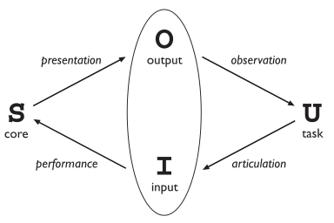
Abowd and Beale framework
extension of Norman…
their interaction framework has 4 parts
  user
  input
  system
  Output
each has its own unique language
interaction ⇒ translation between languages
problems in interaction = problems in translation

Slide 14
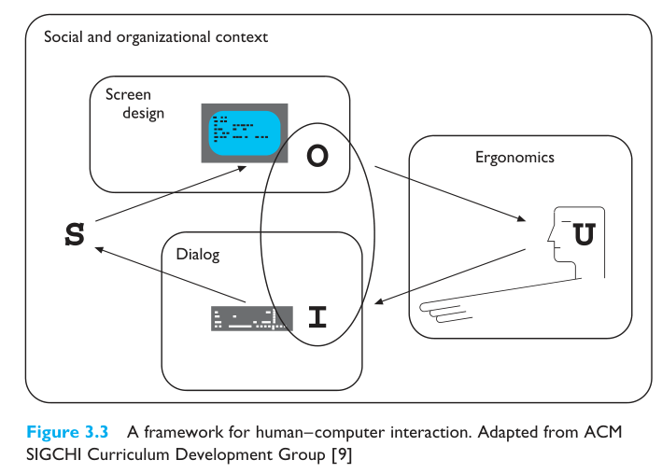

Slide 15
Using Abowd & Beale’s model
user intentions
→ translated into actions at the interface
→ translated into alterations of system state
→ reflected in the output display
→ interpreted by the user
general framework for understanding interaction
  not restricted to electronic computer systems
  identifies all major components involved in interaction
  allows comparative assessment of systems
  an abstraction

Slide 16
ergonomics
physical aspects of interfaces
industrial interfaces

Slide 17
Ergonomics
Study of the physical characteristics of interaction
Also known as human factors – but this can also be used to mean much of HCI!
Ergonomics good at defining standards and guidelines for constraining the way we design certain aspects of systems

Slide 18
Ergonomics - examples
arrangement of controls and displays
  e.g. controls grouped according to function or frequency of use, or sequentially
surrounding environment
  e.g. seating arrangements adaptable to cope with all sizes of user
health issues
  e.g. physical position, environmental conditions (temperature, humidity), lighting, noise,
use of colour
  e.g. use of red for warning, green for okay,
  awareness of colour-blindness etc.

Slide 19

Industrial interfaces
Office interface vs. industrial interface?
Context matters!
office industrial
type of data textual numeric
rate of change slow fast
environment clean dirty
… the oil soaked mouse!

Slide 20
Glass interfaces ?
industrial interface:
  traditional … dials and knobs
  now … screens and keypads
glass interface
  cheaper, more flexible,
  multiple representations,
  precise values
  not physically located,
  loss of context,
  complex interfaces
may need both
Vessel B Temp
0
100
200
113
multiple representations
of same information

Slide 21
Indirect manipulation
office– direct manipulation
  user interacts
  with artificial world
system
industrial – indirect manipulation
  user interacts
  with real world
  through interface
issues ..
  feedback
  delays
interface
plant
immediate
feedback
instruments

Slide 22
interaction styles
dialogue … computer and user
distinct styles of interaction

Slide 23
Common interaction styles
command line interface
menus
natural language
question/answer and query dialogue
form-fills and spreadsheets
WIMP
point and click
three–dimensional interfaces

Slide 24
Command line interface
Way of expressing instructions to the computer directly
  function keys, single characters, short abbreviations, whole words, or a combination
suitable for repetitive tasks
better for expert users than novices
offers direct access to system functionality
command names/abbreviations should be meaningful!
Typical example: the Unix system

Slide 25
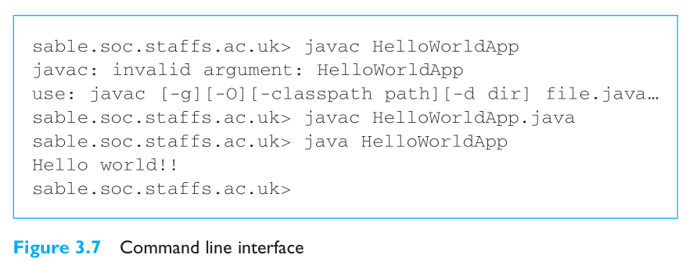

Slide 26
Menus
Set of options displayed on the screen
Options visible
  less recall - easier to use
  rely on recognition so names should be meaningful
Selection by:
  numbers, letters, arrow keys, mouse
  combination (e.g. mouse plus accelerators)
Often options hierarchically grouped
  sensible grouping is needed
Restricted form of full WIMP system

Slide 27
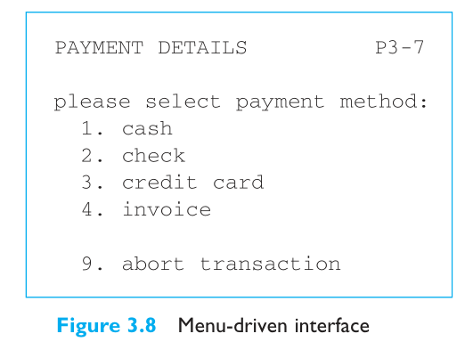

Slide 28
Natural language
Familiar to user
speech recognition or typed natural language
Problems
  vague
  ambiguous
  hard to do well!
Solutions
  try to understand a subset
  pick on key words
  The boy hit the dog with the stick

Slide 29
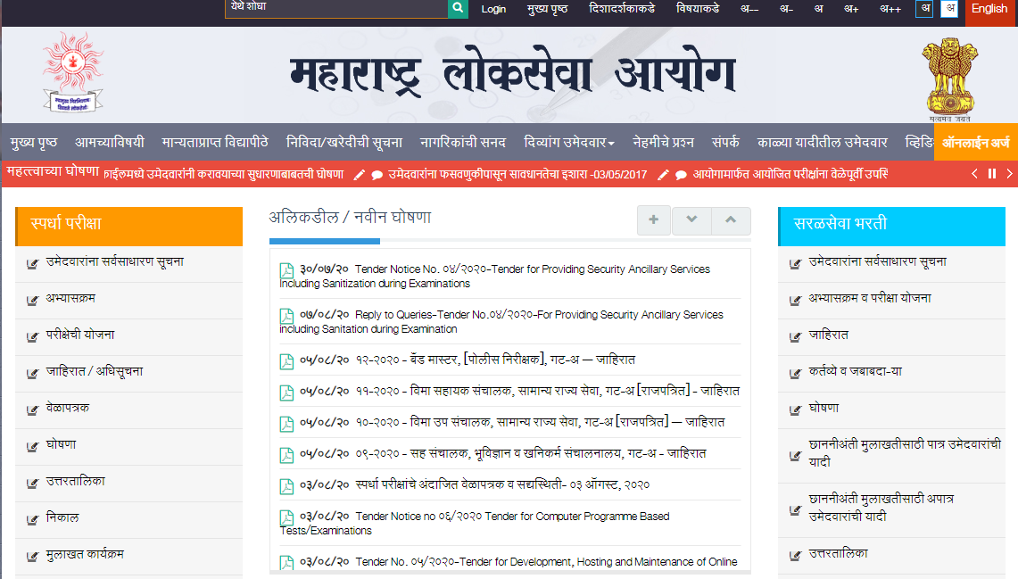

Slide 30
Query interfaces
Question/answer interfaces
  user led through interaction via series of questions
  suitable for novice users but restricted functionality
  often used in information systems
Query languages (e.g. SQL)
  used to retrieve information from database
  requires understanding of database structure and language syntax, hence requires some expertise

Slide 31
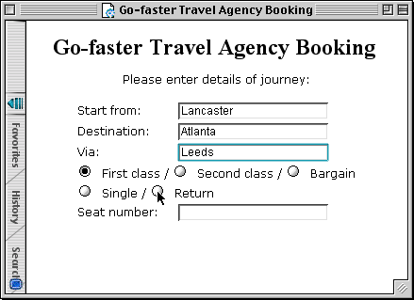
Form-fills
Primarily for data entry or data retrieval
Screen like paper form.
Data put in relevant place
Requires
  good design
  obvious correction
  facilities

Slide 32
Spreadsheets
first spreadsheet VISICALC, followed by Lotus 1-2-3
MS Excel most common today
sophisticated variation of form-filling.
  grid of cells contain a value or a formula
  formula can involve values of other cells
  e.g. sum of all cells in this column
  user can enter and alter data spreadsheet maintains consistency

Slide 33
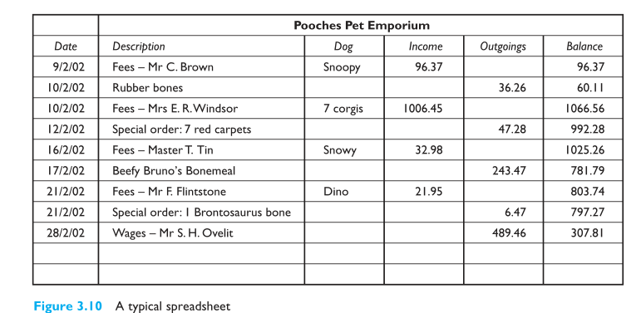

Slide 34
WIMP Interface
Windows
Icons
Menus
Pointers
… or windows, icons, mice, and pull-down menus!
default style for majority of interactive computer systems, especially PCs and desktop machines

Slide 35
Point and click interfaces
used in ..
  multimedia
  web browsers
  hypertext
just click something!
  icons, text links or location on map
minimal typing

Slide 36


Three dimensional interfaces
virtual reality
‘ordinary’ window systems
  highlighting
  visual affordance
  indiscriminate use
  just confusing!
3D workspaces
  use for extra virtual space
  light and occlusion give depth
  distance effects
flat buttons …
click me!
… or sculptured

Slide 37
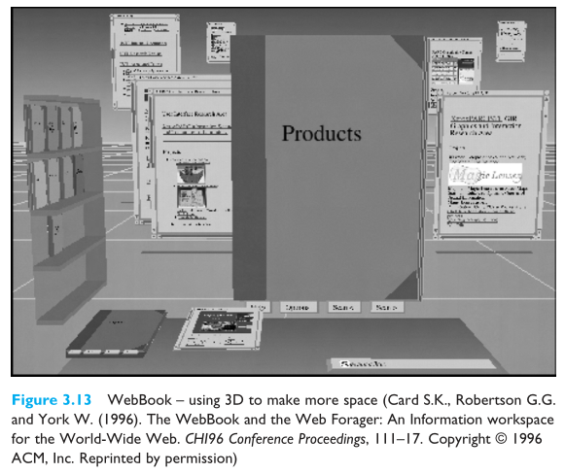

Slide 38
elements of the wimp interface
windows, icons, menus, pointers
+++
buttons, toolbars,
palettes, dialog boxes
also see supplementary material
on choosing wimp elements

Slide 39
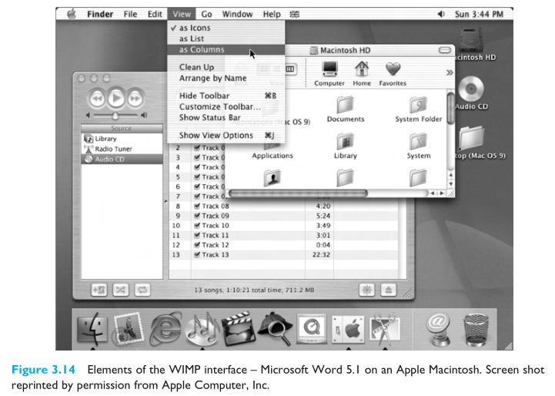

Slide 40
Windows
Areas of the screen that behave as if they were independent
  can contain text or graphics
  can be moved or resized
  can overlap and obscure each other, or can be laid out next to one another (tiled)
scrollbars
  allow the user to move the contents of the window up and down or from side to side
title bars
  describe the name of the window

Slide 41
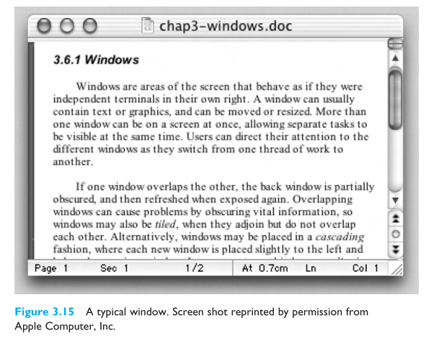

Slide 42
Icons
small picture or image
represents some object in the interface
  often a window or action
windows can be closed down (iconised)
  small representation ﬁ many accessible windows
icons can be many and various
  highly stylized
  realistic representations.

Slide 43
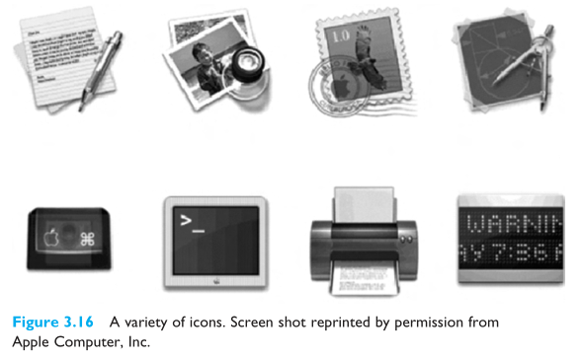

Slide 44
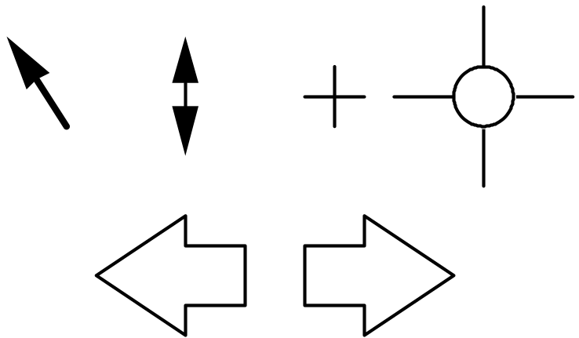
Pointers
important component
  WIMP style relies on pointing and selecting things
uses mouse, trackpad, joystick, trackball, cursor keys or keyboard shortcuts
wide variety of graphical images

Slide 45
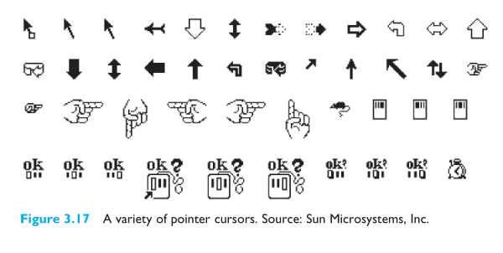

Slide 46
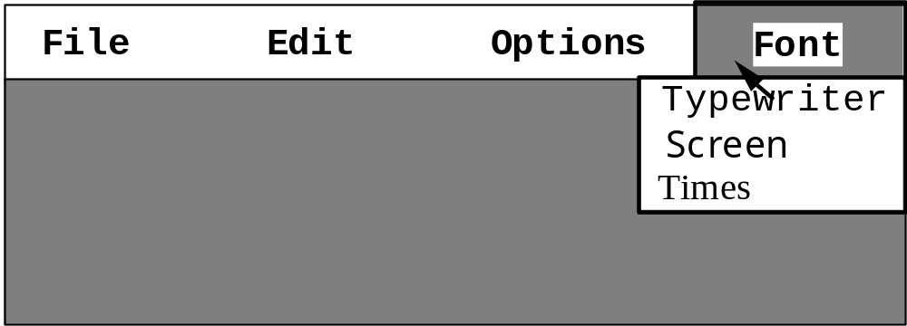
Menus
Choice of operations or services offered on the screen
Required option selected with pointer
problem – take a lot of screen space
solution – pop-up: menu appears when needed

Slide 47
Kinds of Menus
Menu Bar at top of screen (normally), menu drags down
  pull-down menu - mouse hold and drag down menu
  drop-down menu - mouse click reveals menu
  fall-down menus - mouse just moves over bar!
Contextual menu appears where you are
  pop-up menus - actions for selected object
  pie menus - arranged in a circle
    easier to select item (larger target area)
    quicker (same distance to any option)
    … but not widely used!

Slide 48
Menus extras
Cascading menus
  hierarchical menu structure
  menu selection opens new menu
  and so in ad infinitum
Keyboard accelerators
  key combinations - same effect as menu item
  two kinds
    active when menu open – usually first letter
    active when menu closed – usually Ctrl + letter
  usually different !!!

Slide 49
Menus design issues
which kind to use
what to include in menus at all
words to use (action or description)
how to group items
choice of keyboard accelerators

Slide 50
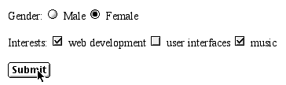
Buttons
individual and isolated regions within a display that can be selected to invoke an action
Special kinds
  radio buttons
  – set of mutually exclusive choices
  check boxes
  – set of non-exclusive choices

Slide 51
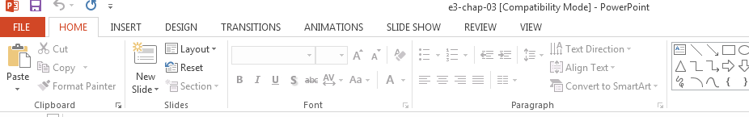
Toolbars
long lines of icons …
… but what do they do?
fast access to common actions
often customizable:
  choose which toolbars to see
  choose what options are on it

Slide 52
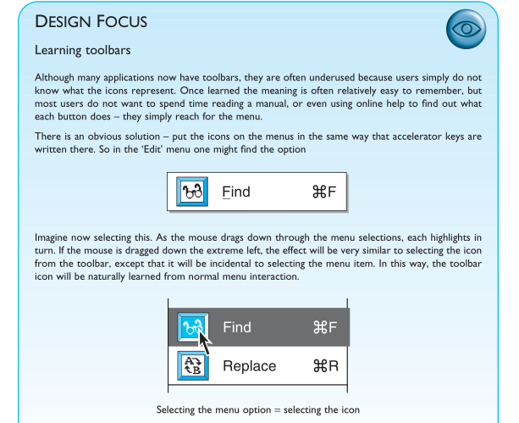

Slide 53
Palettes and tear-off menus
Problem
menu not there when you want it
Solution
palettes – little windows of actions
  shown/hidden via menu option
  e.g. available shapes in drawing package
tear-off and pin-up menus
  menu ‘tears off’ to become palette

Slide 54
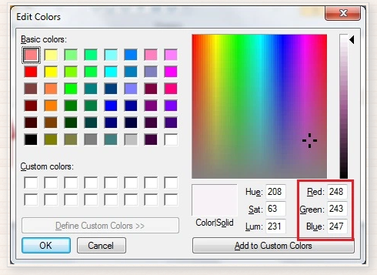

Slide 55
Dialogue boxes
information windows that pop up to inform of an important event or request information.
  e.g: when saving a file, a dialogue box is displayed to allow the user to specify the filename and location. Once the file is saved, the box disappears.

Slide 56
interactivity
easy to focus on look
what about feel?

Slide 57
Speech–driven interfaces
rapidly improving …
… but still inaccurate
how to have robust dialogue?
… interaction of course!
e.g. airline reservation:
reliable “yes” and “no”
+ system reflects back its understanding
“you want a ticket from New York to Boston?”

Slide 58
Look and … feel
WIMP systems have the same elements:
windows, icons., menus, pointers, buttons, etc.
but different window systems
… behave differently
  e.g. MacOS vs Windows menus
appearance + behaviour = look and feel

Slide 59
Initiative
who has the initiative?
old question–answer – computer
WIMP interface – user
WIMP exceptions …
pre-emptive parts of the interface
modal dialog boxes
  come and won’t go away!
  good for errors, essential steps
  but use with care

Slide 60
Error and repair
can’t always avoid errors …
… but we can put them right
make it easy to detect errors
… then the user can repair them
hello, this is the Go Faster booking system
what would you like?
(user) I want to fly from New York to London
you want a ticket from New York to Boston
(user) no
sorry, please confirm one at a time
do you want to fly from New York
(user) yes
… … …

Slide 61
Context
Interaction affected by social and organizational context
other people
  desire to impress, competition, fear of failure
motivation
  fear, allegiance, ambition, self-satisfaction
inadequate systems
  cause frustration and lack of motivation

Slide 62
Experience, engagement and fun
designing experience
physical engagement
managing value

Slide 63
Experience?
home, entertainment, shopping
  not enough that people can use a system
  they must want to use it!
psychology of experience
  flow (Csikszentimihalyi)
  balance between anxiety and boredom
education
  zone of proximal development
  things you can just do with help
wider ...
  literary analysis, film studies, drama

Slide 64
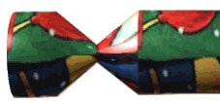
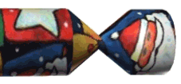
Designing experience
real crackers
  cheap and cheerful!
  bad joke, plastic toy, paper hat
  pull and bang

Slide 65
Designing experience
virtual crackers
  cheap and cheerful
  bad joke, web toy, cut-out mask
  click and bang

Slide 66


Designing experience
virtual crackers
  cheap and cheerful
  bad joke, web toy, cut-out mask
  click and bang

Slide 67





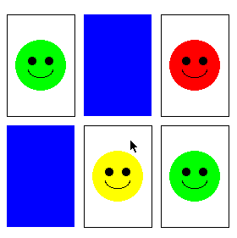
how crackers work
fill in web form
sender
To: wxv
From: ..
receive email
recipient
closed
cracker page
open
message
watches
progress
recipient clicks
cracker opens ...
very slowly
open
cracker page
joke
links
sender
mask
web toy

Slide 68
The crackers experience
real cracker virtual cracker
Surface elements
design cheap and cheerful simple page/graphics
play plastic toy and joke web toy and joke
dressing up paper hat mask to cut out
Experienced effects
shared offered to another sent by email message
co-experience pulled together sender can't see content until opened by recipient
excitement cultural connotations recruited expectation
hiddenness contents inside first page - no contents
suspense pulling cracker slow ... page change
surprise bang (when it works) WAV file (when it works)

Slide 69
Physical design
many constraints:
  ergonomic – minimum button size
  physical – high-voltage switches are big
  legal and safety – high cooker controls
  context and environment – easy to clean
  aesthetic – must look good
  economic – … and not cost too much!

Slide 70
Design trade-offs
constraints are contradictory … need trade-offs
within categories:
  e.g. safety – cooker controls
    front panel – safer for adult
    rear panel – safer for child
between categories
  e.g. ergonomics vs. physical – MiniDisc remote
    ergonomics – controls need to be bigger
    physical – no room!
    solution – multifunction controls & reduced functionality

Slide 71
Fluidity
do external physical aspects reflect logical effect?
  related to affordance (chap 5)
  logical state revealed in physical state?
      e.g. on/off buttons
  inverse actions inverse effects?
      e.g. arrow buttons, twist controls

Slide 72
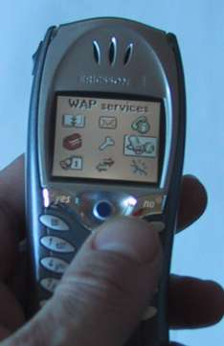
inverse actions
yes/no buttons
  well sort of
‘joystick’
also left side control

Slide 73
spring back controls
one-shot buttons
joystick
some sliders
good – large selection sets
bad – hidden state

Slide 74
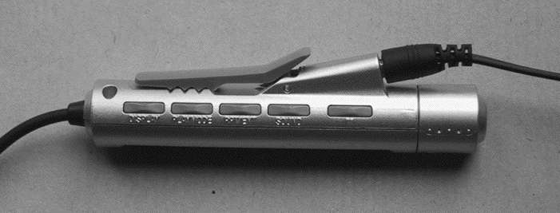
a minidisk controller
twist for track movement
pull and twist for volume
– spring back
– natural inverse for twist
series of spring-back controls
each cycle through some options
–natural inverse back/forward

Slide 75

physical layout
controls:
logical relationship
~ spatial grouping

Slide 76
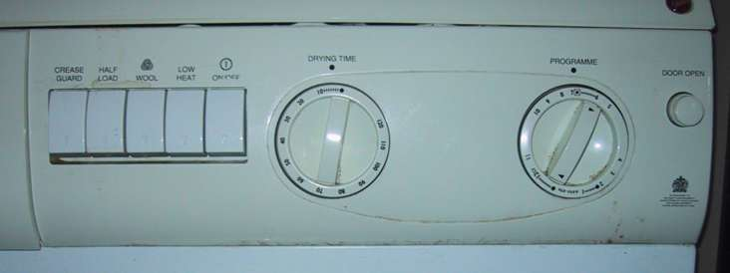
compliant interaction
state evident in
mechanical buttons
rotary knobs reveal internal state and can be controlled by both user and machine

Slide 77
Managing value
people use something
ONLY IF
it has perceived value
AND
value exceeds cost
BUT NOTE
exceptions (e.g. habit)
value NOT necessarily personal gain or money

Slide 78
Weighing up value
value
    helps me get my work done
    fun
    good for others
cost
    download time
    money £, $, €
    learning effort

Slide 79
Discounted future
in economics Net Present Value:
  discount by (1+rate)^{years to wait}
in life people heavily discount
  future value and future cost
  hence resistance to learning
  need low barriers
  and high perceived present value

Slide 80
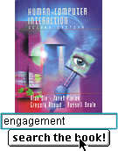
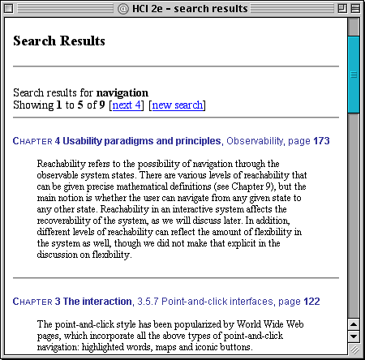
example – HCI book search
value for people who have the book
helps you to look up things
      chapter and page number
value for those who don’t …
sort of online mini-encyclopaedia
      full paragraph of context
… but also says “buy me”!!
… but also says “buy me”!!

Slide 81
Value and organisational design
coercion
    tell people what to do!
    value = keep your job
enculturation
    explain corporate values
    establish support (e.g share options)
emergence
    design process so that
    individuals value → organisational value

Slide 82
General lesson …
if you want someone to do something …
make it easy for them!
understand their values

